Slide 1

VAISHNAVI V 2021506116 B.TECH IT MIT
PRESENTED BY
3/21/2024 Annual Review

Slide 2

VEGETABLE IMAGE CLASSIFICATION USING CNN
3/21/2024 Annual Review

Slide 3


AGENDA
Problem Statement Objective Methodology Model Architecture Training Process Results Applications
Output demo Conclusion
3/21/2024 Annual Review

Slide 4

PROBLEM STATEMENT
Develop a CNN model to accurately classify various types of vegetables from images. The model should be trained on a dataset of labeled vegetable images and evaluated based on metrics such as accuracy, precision, and recall. The goal is to create a robust system capable of automating vegetable classification tasks in agricultural, food processing, and nutritional applications.
3/21/2024 Annual Review

Slide 5

OBJECTIVE
This project focuses on building convolutional neural network (CNN) model for vegetable classification, using a dataset comprising labeled vegetable images. The objective is to train the model to accurately classify various types of vegetables from input images. The ultimate aim is to deploy the trained model in practical applications such as agricultural automation and food processing, streamlining vegetable classification processes and enhancing overall efficiency in relevant industries.
3/21/2024 Annual Review

Slide 6

METHODOLOGY
Data Collection: Assemble a comprehensive dataset of vegetable images covering various types and conditions.
Preprocessing: Standardize image sizes, colors, and orientations for consistent input to the CNN.
Architecture Selection: Choose an appropriate CNN architecture like VGG or ResNet, considering the complexity of the classification task.
Training and Validation: Train the CNN on the training set, adjusting parameters using the validation set to prevent overfitting.
Evaluation: Assess the model's performance on the test set to measure its accuracy and effectiveness in classifying vegetable images.
Deployment: Implement the trained model in real-world applications, continuously refining it based on feedback and performance metrics.
3/21/2024 Annual Review

Slide 7

YOUR SOLUTION AND ITS VALUE PROPOSITION
The solution is a CNN-based vegetable classification system that automates sorting processes for farmers, streamlines production for food processors, aids dietary analysis for nutritionists, and provides convenient vegetable identification for consumers. Its value proposition lies in improving efficieny and decision – making across agricultural, food processing, and nutritional domains
3/21/2024 Annual Review

Slide 8

THE WOW IN YOUR SOLUTION
With its advanced CNN technology, the system revolutionizes sorting for farmers, production for food processors, dietary analysis for nutritionists, and vegetable identification for consumers. Its precision, automation, and convenience redefine efficiency in vegetable-related tasks, marking a significant leap forward in optimizing workflows and decision-making processes.
3/21/2024 Annual Review
8

Slide 9
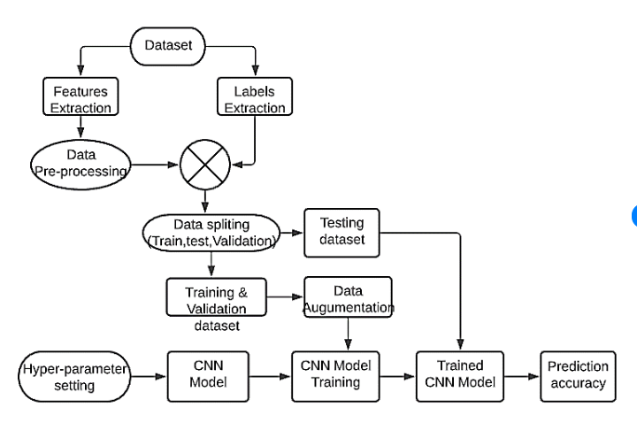

MODELLING
3/21/2024 Annual Review
9

Slide 10

OUTPUT DEMO

Slide 11
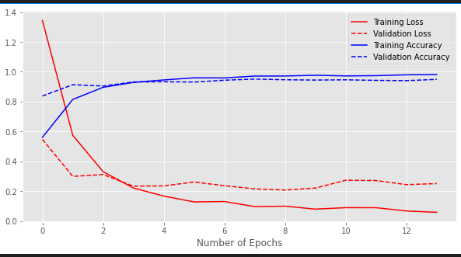
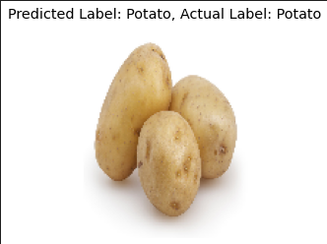
RESULTS
Demo Link
3/21/2024 Annual Review
11

Slide 12
CONCLUSION
In summary, employing Convolutional Neural Networks for vegetable image classification offers a robust framework for effectively identifying different types of vegetables. With meticulous dataset preparation, model fine-tuning, and continuous refinement, CNNs present a promising avenue for advancing agricultural automation and improving crop monitoring and management processes.

